Slide 1

RUNGTA COLLEGE OF DENTAL SCIENCES & RESEARCH
TITLE OF THE TOPIC- ENDODONTIC SURGERY
DEPARTMENT OF – CONSERVATIVE DENTISTRY AND ENDODONTICS

Slide 2
Specific learning Objectives
At the end of this presentation the learner is expected to know ;
Core areas* | Domain ** | Category #
Introduction | Cognitive | Must know
Method | Psychomotor | Must know
Armamentarium | Cognitive | Must know
*Subtopic of importance
** Cognitive, Psychomotor or Affective
# Must know , Nice to know & Desire to know
( Table to be prepared as per the above format )

Slide 3
TABLE OF CONTENTs
Definition
Indication
Contraindication
Classification
Anatomic consideration
Patient preparation
Surgical access
Haemostasis
Root end resection and preparation
Root end filling
Flap closure and suture
Postoperative complications

Slide 4
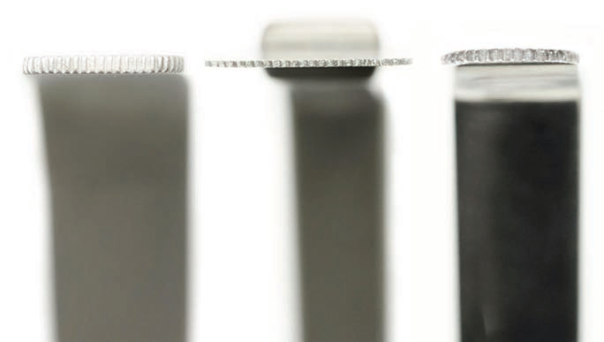
Tissue Retraction Instruments
KimTrac retractors
Variable widths from 8 mm to 14 mm
KimTrac P1 and P2 retractors have wings.
To separate the elevated soft tissue from the area of surgery
One-third the thickness of other retractors
An ideal retractor using the bone grooving technique on mandibular posterior surgery

Slide 5
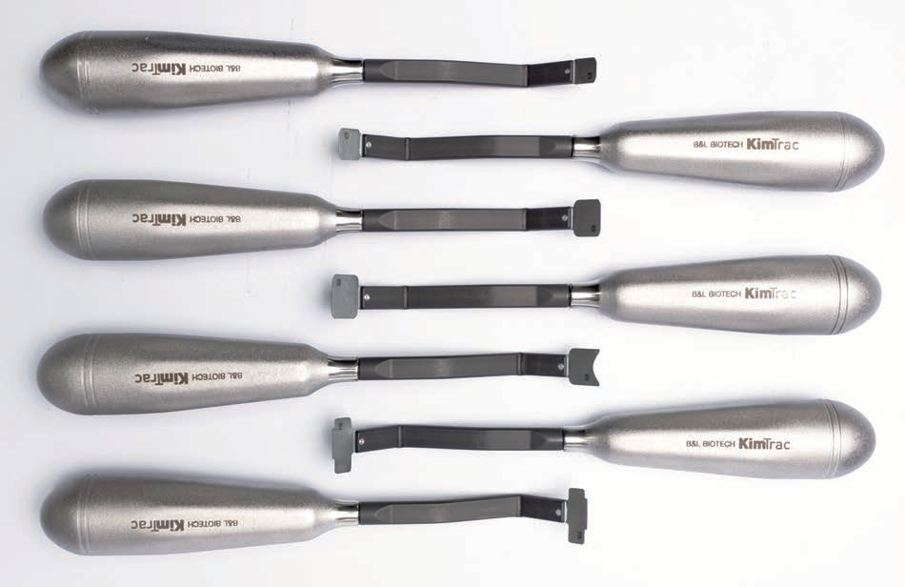

Slide 6
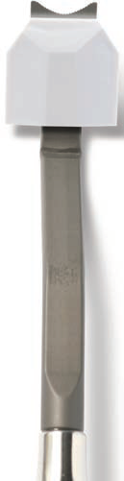
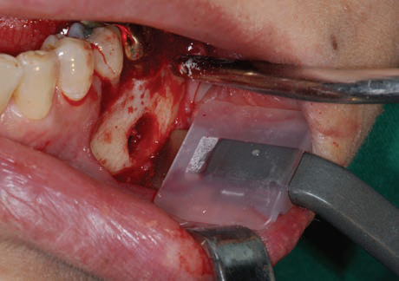
KimTrac can be used with and without a plastic protector.
The plastic protector is advantageous as it ensures easy flap retraction with highly improved visibility and accessibility to the operating field
KimTrac-M5 retractor with a
plastic protector.

Slide 7
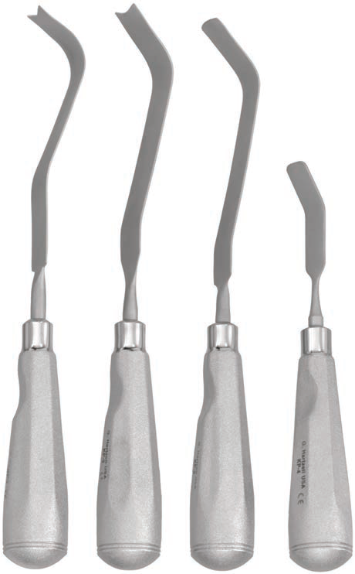
Kim/Pecora (KP) retractors
KP 1, 2, and 3 retractors wider tips than conventional
retractors (15 mm compared with 10 mm) and are 0.5 mm thinner.
Their serrated ends anchor the retractors securely on to the
bone.
The KP 4 retractor is a small, all-purpose retractor with
the same features as the others but has the standard 10-mm width
The KP retractor tips are modeled to the concavities and
convexities of the cortical bony plate.
Notes:
The full contact of the retractor tip on the bone provides a secure, stable hold, eliminating sudden or creeping slippage that results in traumatized tissue, swelling, and painful healing

Slide 8
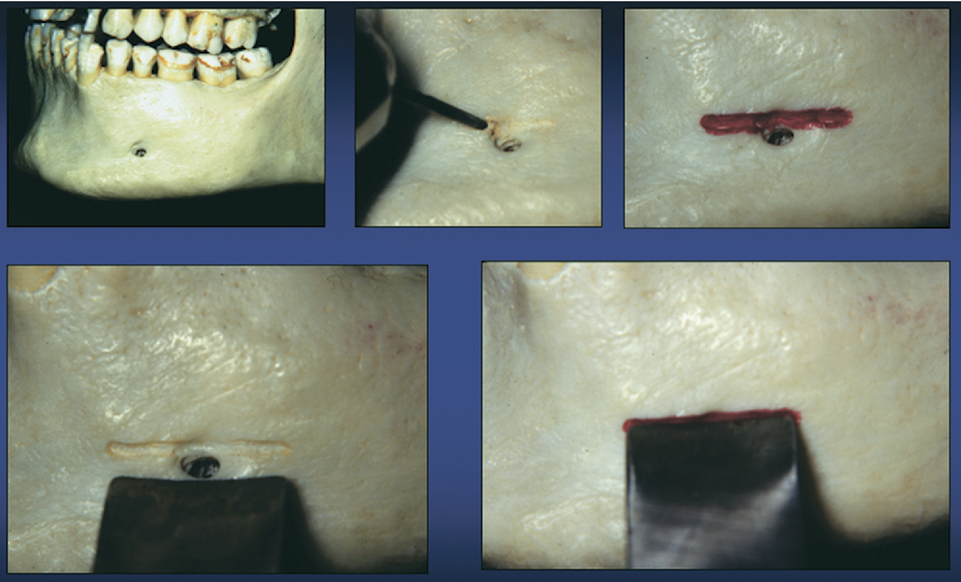
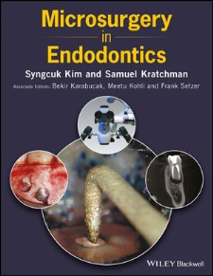
Groove Technique
A 15-mm long horizontal groove is cut into the water-cooled bone with a Lindemann bur or a #4 round bur, beyond the apex to allow space for the osteotomy and subsequent apicoectomy.
The groove permits secure anchoring of the serrated retractor tip and secure, steady
retraction of the flap.

Slide 9

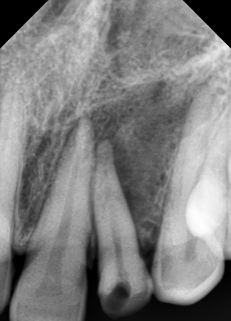
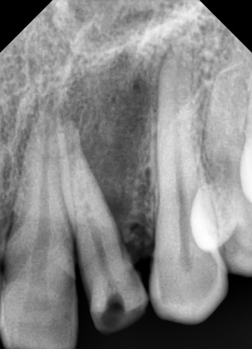
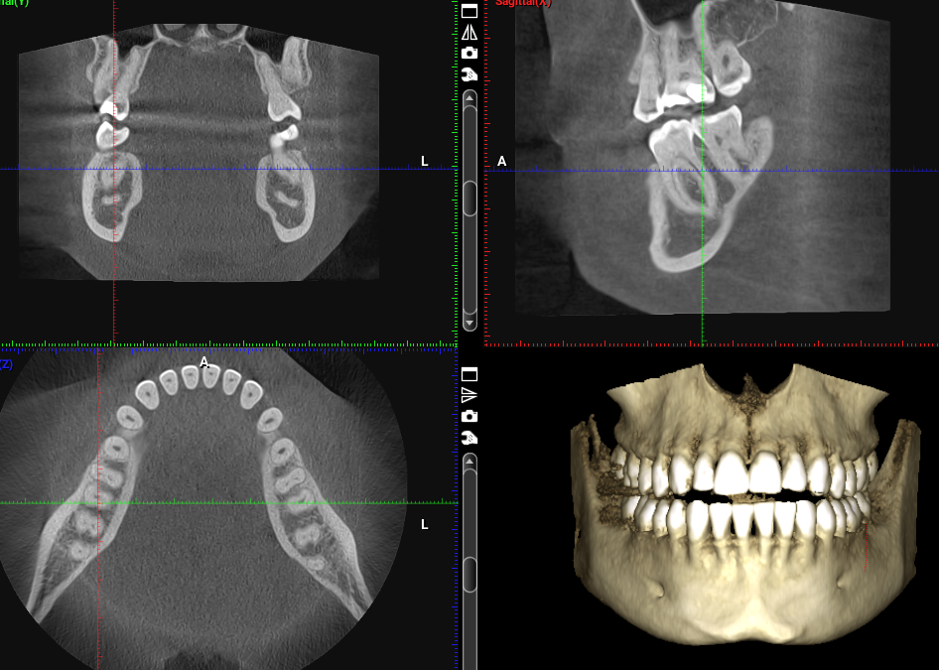
Osteotomy
Osteotomy (ostectomy) — Surgical access in bone, typically used to access root-end.
Length of the roots
The curvature of the roots
The position of the apices in relation to the cusp tips
The number of roots.
The proximity of the apices to apices of adjacent teeth
The proximity of the mental foramen, the mandibular nerve, and sinus space

Slide 10

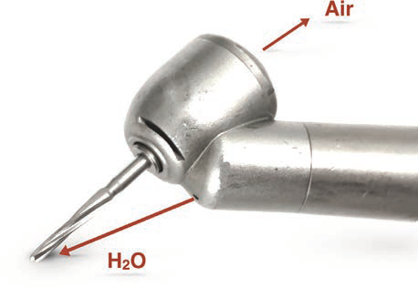
Osteotomy Instruments
45 degree surgical handpiece
Designed to direct water on to the cutting surface by channeling it along the surface of the bur while the air is ejected through the back of the handpiece
This reduces the chance of emphysema and pyemia and creates less splatter than a conventional handpiece.
The handpiece’s 45 degree angled head makes it easier to work in and visualize difficult to reach areas.

Slide 11

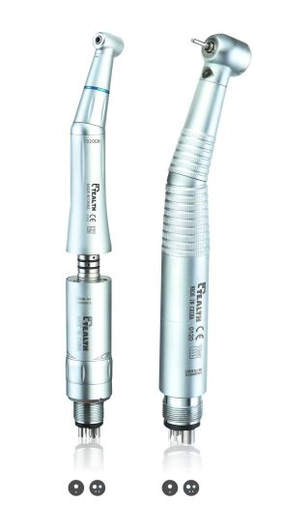

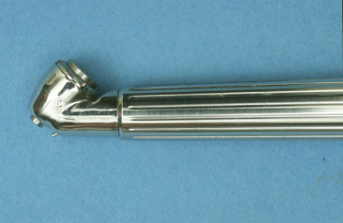
Cutting speed
high-speed handpieces
Healing was more rapid.
Light pressure is needed to cut bone, the reduced time involved in the procedure and improved patient acceptance clinically.
The high-speed range significantly reduced heat production.
Risk of surgical emphysema from the air/water spray
directed at the cutting site
Hoskinson AE. Hard tissue management: osseous access, curettage, biopsy and root isolation. Endod Topics. 2005; 11: 98-113.

Slide 12
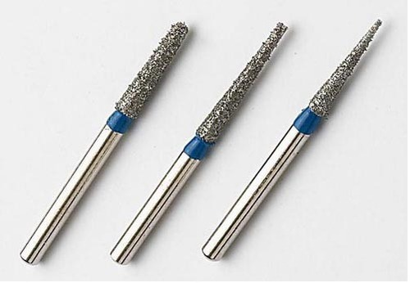
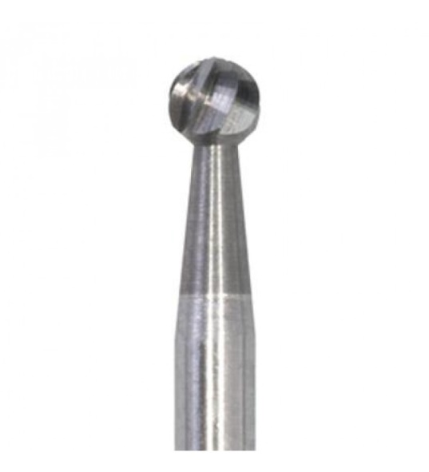
Bur design
Diamond bur
Not recommended
Diamond grit traps bone particles and therefore increases frictional heat.
Produce rougher surfaces
Round carbide bur
Recommended for bone removal.
Minimise bone chips
Provide a uniplanar surface
Unsatisfactory design to resect a root tip
Hoskinson AE. Hard tissue management: osseous access, curettage, biopsy and root isolation. Endod Topics. 2005; 11: 98-113.

Slide 13
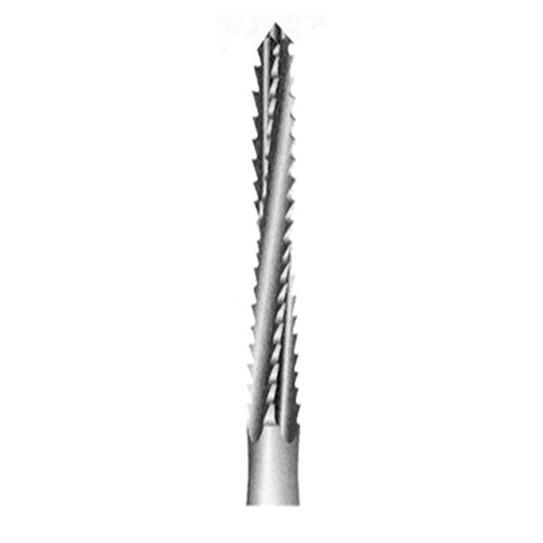
Lindemann bur
For both osteotomy and root-end resection
Fewer flutes than conventional burs, resulting in less clogging and frictional heat and more efficient cutting.
The bone cutter bur is specially designed to remove the bone while minimizing the frictional heat.
The selected bur should run parallel to the surface of the cortical plate with a light brushing action to reduce friction
Hoskinson AE. Hard tissue management: osseous access, curettage, biopsy and root isolation. Endod Topics. 2005; 11: 98-113.
Notes:
Multipurpose

Slide 14
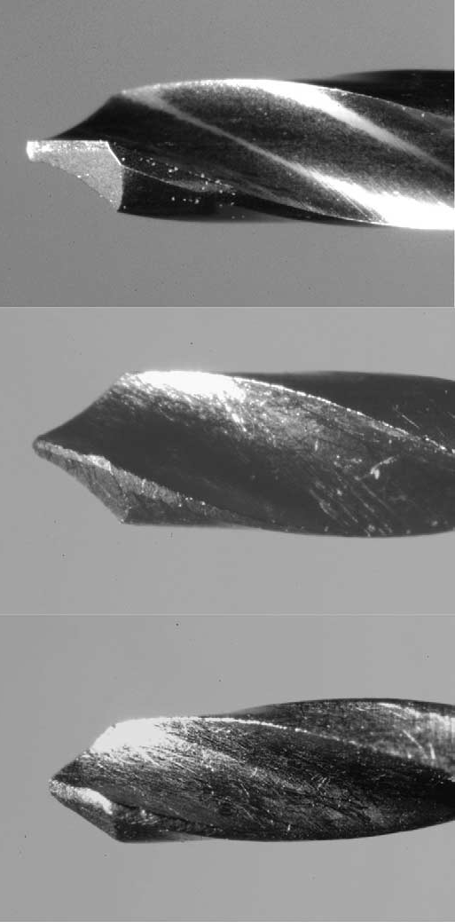
There is no evidence of the effect of used or blunted burs on cutting efficiency and therefore temperature elevation in periradicular surgery
There were significant differences in the temperatures generated;
the temperature rise when a new drill was used was 7.5°C,
a drill used in theatre for an unknown time where the increase was 25°C
They recommended single use burs.
It would be prudent to follow the same advice for surgical burs in periradicular surgery
Allan W, Williams ED, Kerawala CJ. Effects of repeated drill use on temperatures of bone during preparation for osteosynthesis self-tapping screws. Br J Oral Maxillofac Surg 2005: 43: 314–319.

Slide 15
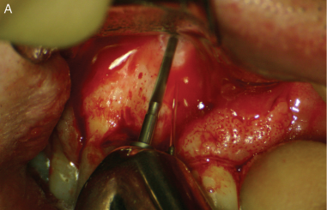
Effect of heat
Heating osseous tissue to 117° to 122° F (47° to 50° C) for 1 minute significantly reduces bone formation and is associated with irreversible cellular damage and fatty cell infiltration..
Eriksson AR, Albrektsson T. Temperature threshold levels for heat-induced bone tissue injury: a vital-microscopic study in the rabbit. J Prosthet Dent. 1983; 50: 101-7.
A constant stream of water or saline is required on the cutting surface of the bur to avoid overheating of the bone
Hoskinson AE. Hard tissue management: osseous access, curettage, biopsy and root isolation. Endod Topics. 2005; 11: 98-113.

Slide 16
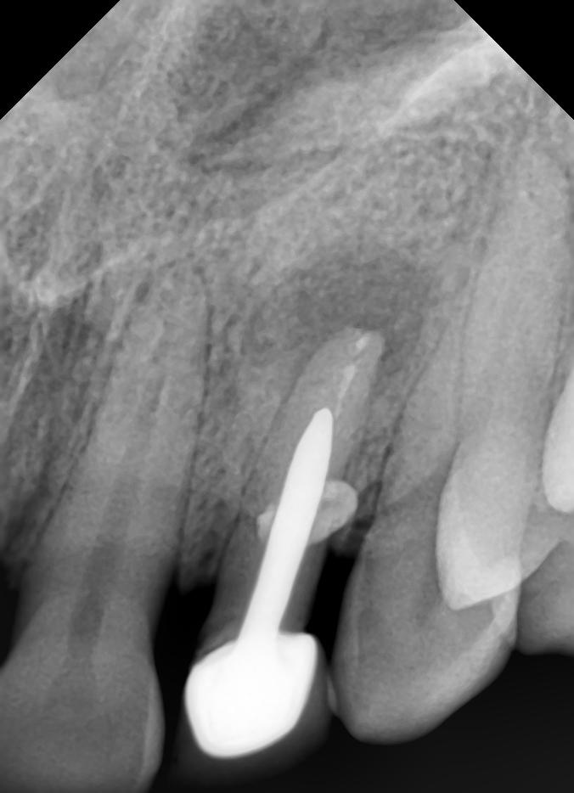
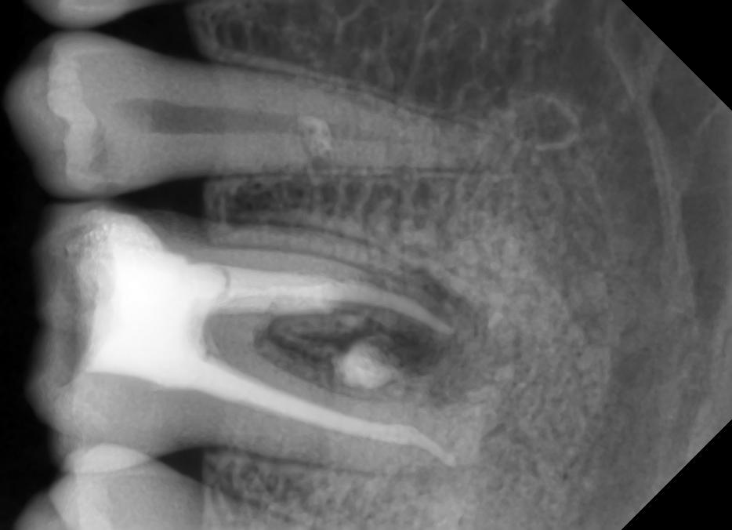
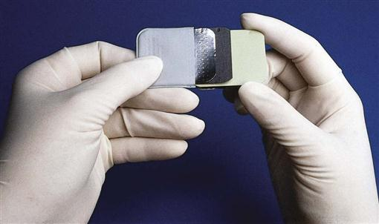
Site of entry
A periapical radiograph is exposed – it is then usually possible to orientate the position of the root apex with the radiopaque marker and extend the osteotomy in the appropriate direction
A technique whereby an initial osteotomy access cavity or depression is made
small piece of lead sheet from IOPA film packet is cut and placed into the site.

Slide 17
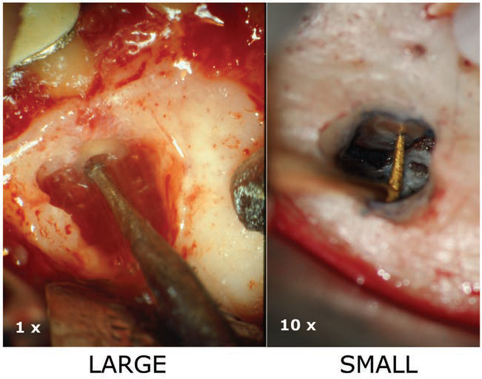
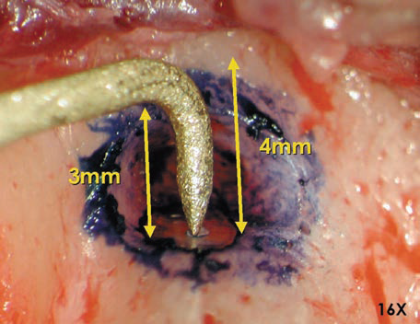
Optimal Osteotomy Size
The size criteria for an osteotomy is just large enough to manipulate ultrasonic tips freely within the bony crypt
The ideal osteotomy is no larger than 4 mm in diameter to accommodate the 3-mm long ultrasonic tip in the bone crypt.
The osteotomy is small but large enough to accommodate the ultrasonic tip.
Rubinstein RA, Kim S. Short-term observation of the results of endodontic surgery with | the use of a surgical operation microscope and Super-EBA as root-end fillingmaterial. J Endod. 1999: 25: 43–48.
Notes:
the smaller the osteotomy, the faster the
healing

Slide 18
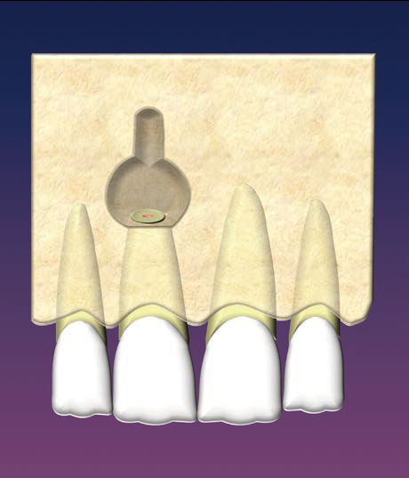
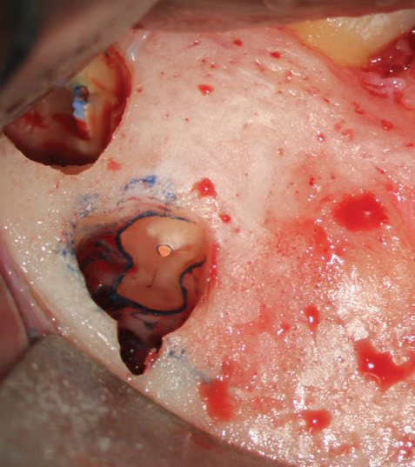
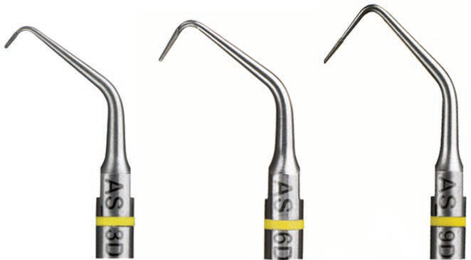
Key Hole Osteotomy Modification
In some cases, a retrograde deeper than 3 mm into
the canal is indicated, especially when performing apical surgeries on anterior teeth. Retrograde ultrasonic tips that can be as long as 9 mm may be used for such preparations. Such tips will not fit in the 4 mm osteotomy suggested by the authors.
A key hole modification to the osteotomy by creating a narrow vertical extension of the osteotomy in an apical direction will create enough space to fit the tip with minimum osseous tissue removal
Ultrasonic tips of varying
lengths: 3 mm, 6 mm, and 9 mm

Slide 19
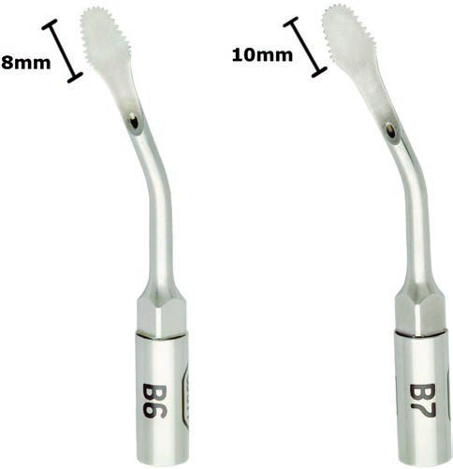
Bone Window Technique
In cases where there is no detectable buccal cortical
plate fenestration, or where a thick cortical plate is
expected, e.g., mandibular second molars
Aims at preserving the buccal cortical plate and
promotes faster healing.
A piezo surgery device is used which resects osseous
tissues with high precision while the surrounding soft
tissue remains uninjured.
W&H Piezome instruments. Fine-toothed saw for
fine cuts with 8 mm and 10 mm depth, with little bone loss when harvesting bone blocks.
Notes:
Newly designed longer fine-toothed saw tips of 10 mm are used to create a rectangular-shaped bone window to uncover the area of the lesion and the
apices of the roots The buccal window walls should be cut in a way that they converge fromthe exterior surface toward the interior surface, creating a resting seat that prevents the plate from sinking internally when repositioned. Two small round holes helpwith maintaining good circulation of the
surgical site. The bone window piece is placed in the Hanks balanced salt solution (HBSS) (

Slide 20
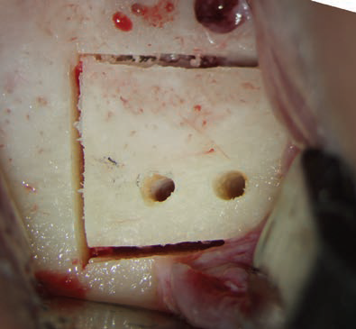
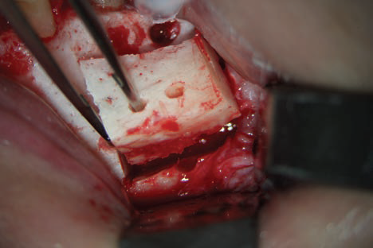
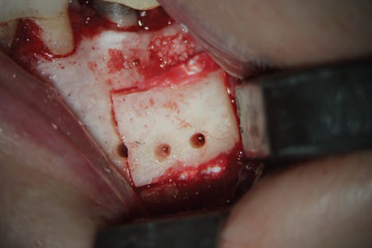
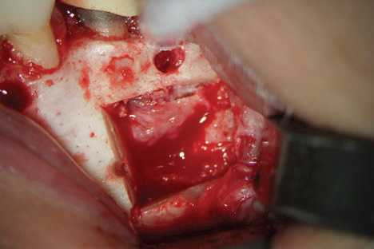
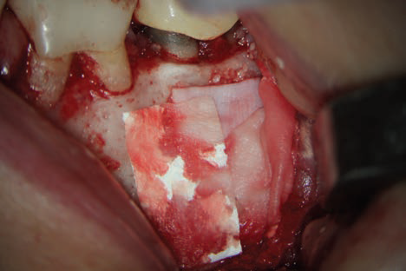
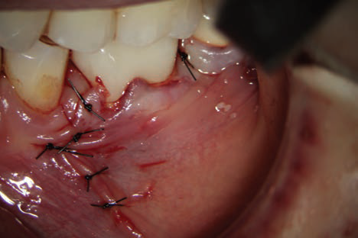
A rectangular window is cut in the buccal cortical plate using Piezomed instruments. Two holes were made to facilitate blood circulation during healing.
Bone window being replaced;
The removed bone window is stored in HBSS solution until the end of the procedure.
granulation tissue exposed;
ultrasonic preparation of resected root tip;
Bioceramic root end filling.
bone window replaced wedging in collagen membrane;
Two collagen membranes placed over the bone window;
sutures placed;
Notes:
A rectangular window is cut in the buccal cortical
plate using Piezomed instruments. Two holes were made to
facilitate blood circulation during healing

Slide 21
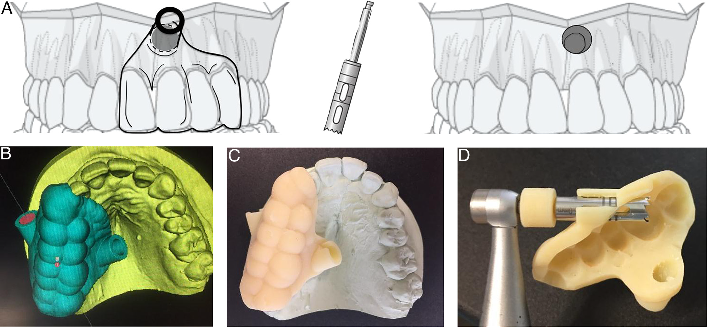
Targeted Endodontic Microsurgery
Uses 3D–printed surgical guides (3DSGs) and trephine burs to achieve single-step osteotomy, root-end resection, and biopsy in these complex cases.
Giacomino et al; Targeted Endodontic Microsurgery: A Novel Approach to Anatomically Challenging Scenarios Using 3-dimensional–printed Guides and
Trephine Burs—A Report of 3 Cases; JOE 2018

Slide 22
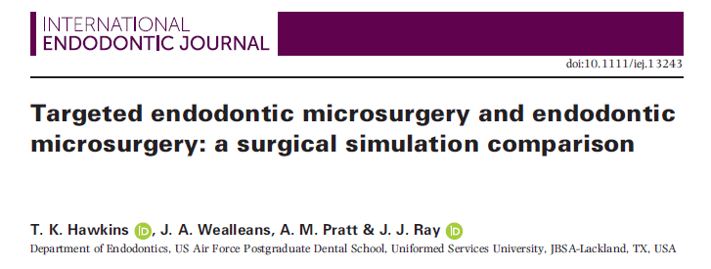
TEMS significantly reduced surgical time, had bevel angles more closely approaching zero degrees and had significantly less volume of over-resection
Helpful in anatomically challenging scenarios and where damage to adjacent teeth can occur.

Slide 23
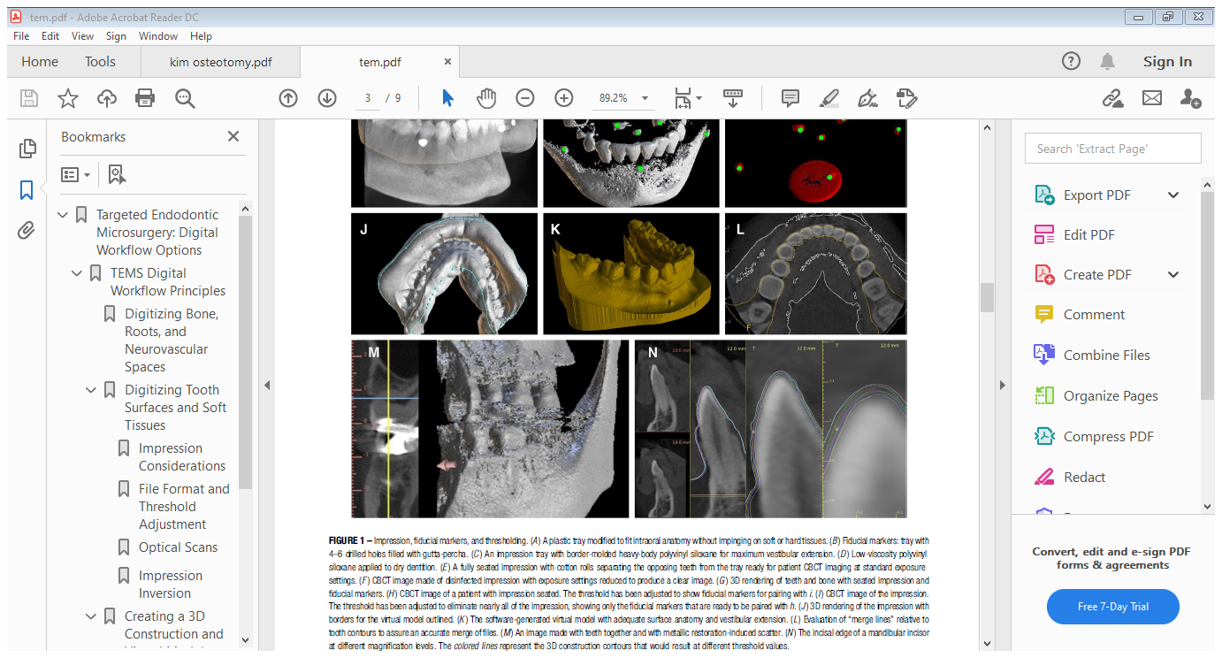
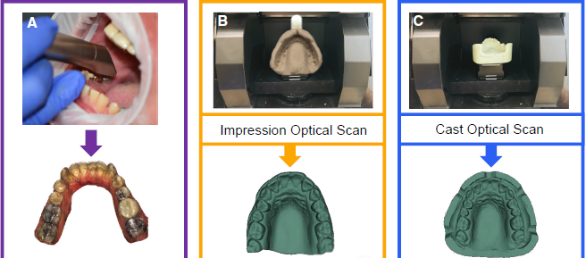
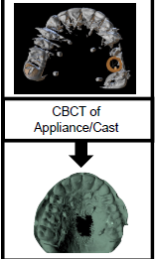
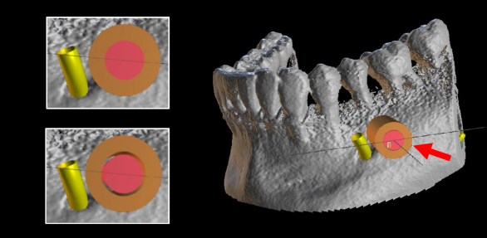
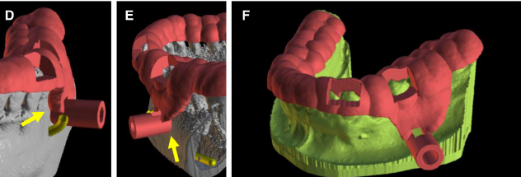
TEMS: Digital Workflow Options
The TEMS digital workflow converts the patient’s anatomy into digital data in 4 steps.
1
2
3
4
Ray et al; Targeted Endodontic Microsurgery: Digital Workflow Options; J Endond 2020
Notes:
First, bone, teeth, and neurovascular spaces are rendered with cone-beam computed tomographic imaging. Next, crowns and soft tissues are rendered with an intraoral optical
scan, a benchtop optical scan of an impression or cast, or a cone-beam computed
tomographic scan of an impression or cast.
. Third, these renderings are merged within design
software to create a 3D construction containing a virtual model. Finally, guide design is
performed on the virtual model for 3D printing. Blue Sky Plan software

Slide 24
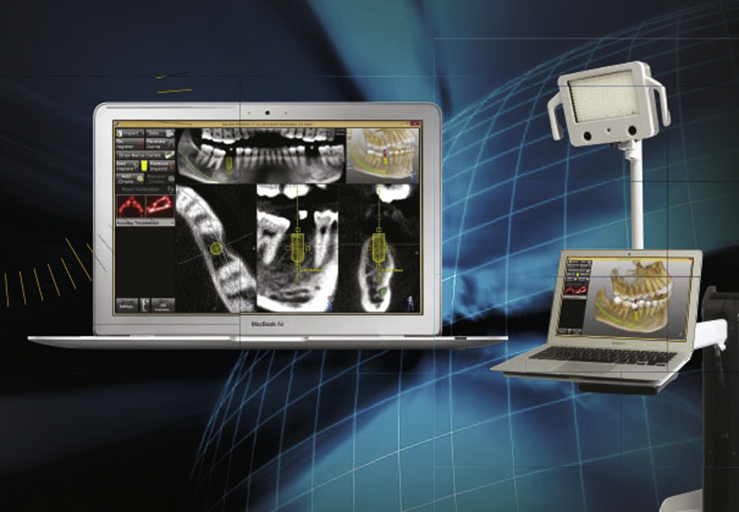
Dynamic Navigation System
Dynamic navigation integrates surgical instrumentation and radiologic images using an optical positioning device controlled by a dedicated computerized interface.
A clinical real-time interface displays and guides users to drill into the targeted position through the prefixed trace according to the output of the preoperative planning software
The Navident navigation system device.
Gambarini G, Galli M, Stefanelli LV, Di Nardo D, Morese A, Seracchiani M, De Angelis F, Di Carlo S, Testarelli L. Endodontic microsurgery using dynamic navigation system: a case report. Journal of endodontics. 2019 Nov 1;45(11):1397-402.

Slide 25
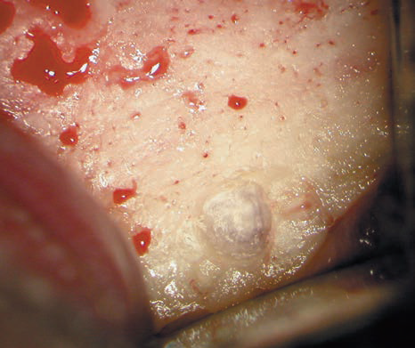
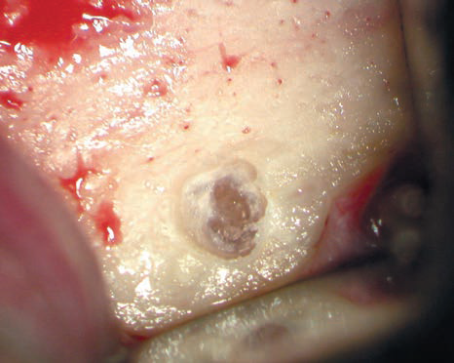


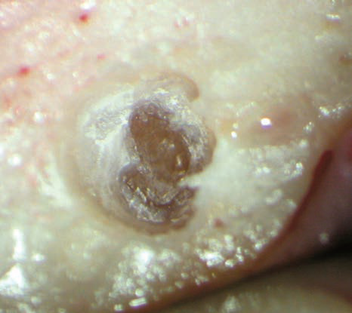
DISTINGUISH BETWEEN BONE AND ROOT
white, soft,
and bleeds when scraped with a probe
darker, yellowish color, and
is hard

Slide 26

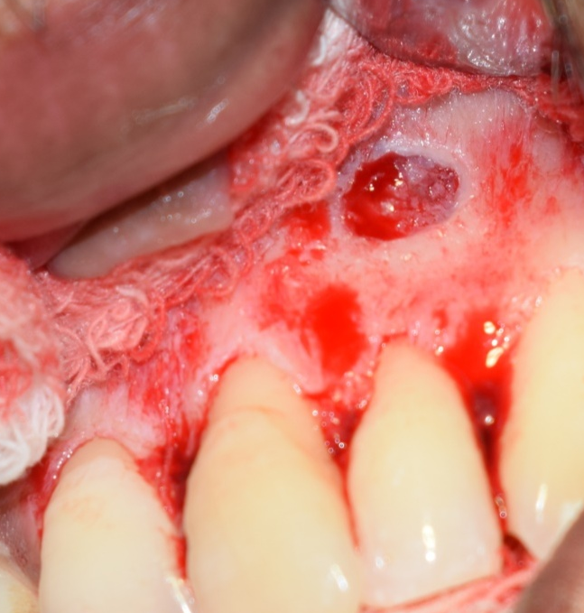
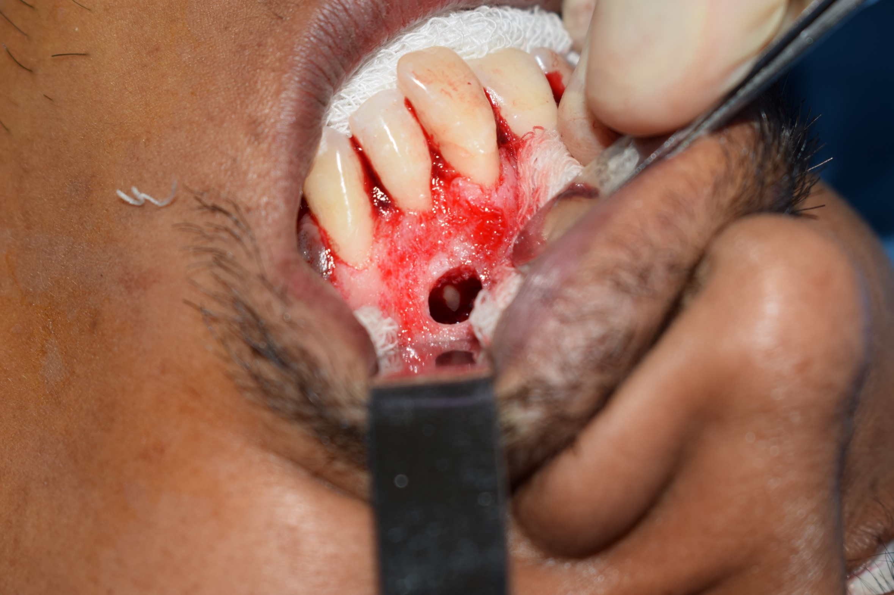
When the root tip cannot be distinguished from its surroundings, the osteotomy site is stained with methylene blue, which preferentially stains the periodontal ligament
The surgeon must be very observant for even the smallest irregularity in the bone,
which is usually the root tip.
The advantage of using the microscope for this procedure is the minimal removal of healthy bone structure

Slide 27
Piezosurgery is a new and innovative method that uses piezoelectric ultrasonic vibrations to perform precise and safe osteotomies.
It was developed in 1988 by the Italian oral surgeon Tomaso Vercellotti to overcome the limitations of conventional bone surgery.
The instrument uses a modulated ultrasonic frequency that permits the cutting of hard tissues. The vibrations obtained are amplified and transferred to a vibration tip, which, when applied with slight pressure to bone tissue, results in a cavitation phenomenon—a mechanical cutting effect that occurs exclusively in mineralized tissue
:the initial financial burden associated with the purchase of the device,
:the long duration of the surgical procedure, and the fact that the instruction
:manuals of many piezoelectric units discourage use of these devices
in patients with implanted cardiac pacemakers
protection of soft tissues,
optimal visualization of the surgical field,
decreased blood loss,
reduced vibration and noise,
increased comfort for the patient, and
protection of tooth structures
Abella F, de Ribot J, Doria G, Duran-Sindreu F, Roig M. Applications of piezoelectric surgery in endodontic surgery: a literature review. Journal of endodontics. 2014 Mar 1;40(3):325-32.

Slide 28
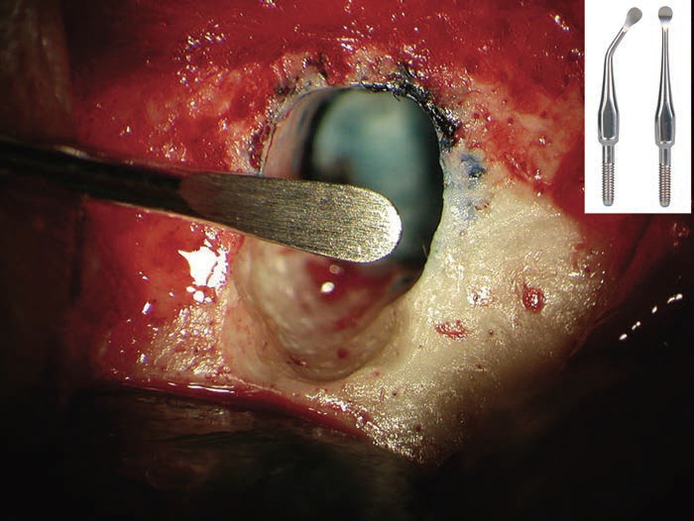
Surgical curettage
The aim of curettage is to remove the periradicular soft tissue lesion that represents the apical periodontitis to allow optimal access and visualization of the apical third of the relevant root or roots
Notes:
removal of the soft tissue lesion in its entirety is considered unnecessary, as remaining tissue remnants will be incorporated into the new granulation tissue as past of the healing process.
Even if an epithelial lining were present, a radicular cystic lesion would be significantly disrupted by incomplete curettage and is likely to heal.

Slide 29
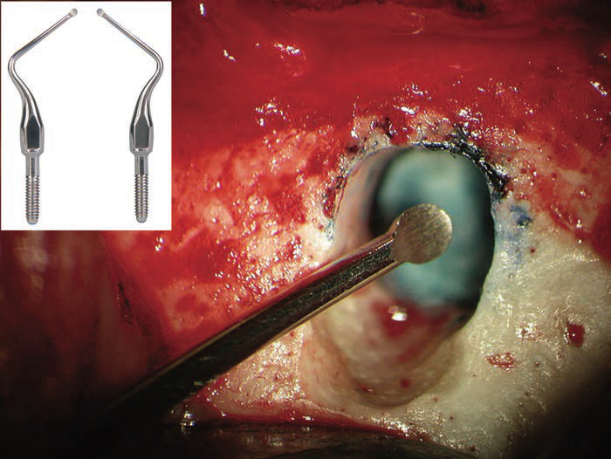
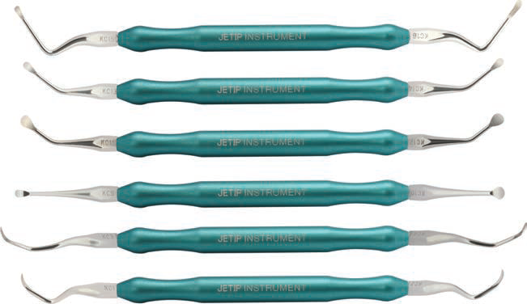
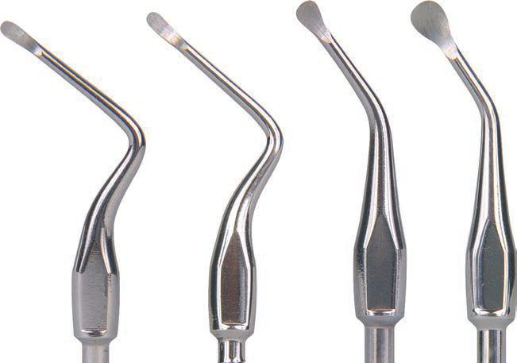
Curettage instruments include,
periodontal curettes
surgical curettes
mini endodontic curettes
Curettage Instruments
2/4 MOLT SURGICAL CURETTE
The 2/4 Molt surgical curette is designed for curettage, cyst removal and tooth socket debridement with 3.6mm and 7mm working ends.

Slide 30
TAKE HOME MESSEGE/ FOR THE TOPIC COVERED (SUMMARY)
The principle treatment modalities for the management of post-treatment periapical pathosis are orthograde retreatment and apical surgery.
A significant advantage to surgical intervention is that it offers immediate access to the root apex.
Furthermore, it includes curettage of the periradicular granulomatous tissues and the resection of the apical 3 mm of the root, which frequently contains infected canal ramifications

Slide 31
Question & Answer Session
1. Write a short note on tissue retraction instruments.
2. Write in brief about bone window technique.
3. Short note on osteotomy instruments .

Slide 32
REFERENCES
NAME OF THE BOOK WITH EDITION AND PAGE NUMBERS
ARTICLE ARE TO BE MENTIONED IF NEEDED
Ingle JI, Bakland LK. Endodontics. 4th ed. Philadelphia:Williams and Wilkins; 1995.
Grossman LI, Oliet S, Del Rio C. Endodontics. 11th ed. Philadelphia: Lea and Febiger; 1988
Rowe AHR. Damage to the inferior dental nerve during or following endodontic treatment. Br Dent J 1983;153:306
Seltzer S, Bender IB, Turkenkopf S. Factors affecting successful repair after root canal therapy. J Am Dent Assoc 1963;67:651
Walia H, et al. Use of a hemostatic agent in the repair of procedural errors. JOE 1988;14:465.

Slide 33


